Slide 1
NGAS ATMS SDR CalVal Activity and Highlights
Alex Foo and Degui Gu
October 23, 2012

Slide 2
NGAS Responsibilities for NPP ATMS Cal/Val
NGAS ATMS team supports NPP ATMS Cal/Val by applying our in-depth knowledge of ATMS sensor hardware, ATMS SDR algorithm science and algorithm operational implementation at IDPS
Main responsibilities include
  Support the Cal/Val team to verify IDPS xDR data products including data format, content and quality
  Support to DR investigation and anomaly resolution
  Support to fine tuning of algorithm code and LUTs/processing coefficients
  Provide LUT and PCT updates and perform verification testing using operational code on GRAVITE ADA

Slide 3
Overview
Sensor Performance assessment
ATMS SDR scan dependent bias assessment
ATMS striping noise investigation
ATMS remap SDR validation
DR and anomaly resolution
ATMS operational algorithm updates and verification
ATMS SDR derived product (temperature/moisture profile EDRs)

Slide 4
NGAS ATMS Cal/Val Highlights (1/7)
Supported ATMS sensor performance verification, with focus on the assessment of sensor calibration data uniformity, stability and consistency
  Warmload temperatures were stable, showing small and repeatable orbital patterns of temperature variability ~0.2K for KAV bands and ~0.4K for WG bands, respectively. Also noticed some diurnal variability with a daily temperature variation of ~0.5K for KAV bands and ~0.7K for the WG bands, respectively
  Warmload temperatures were uniform, with typical temperature contrasts around 40-50mK and maximum contrasts around 100mK among different PRTs within each band
  Examination of calibration data (WC, DC, PRT temperatures and Gains) revealed some degree of inconsistency between calibration data, likely affecting SDR calibration accuracy. Some channels are more affected (e.g., channel 16 and channel 1) than others

Slide 5
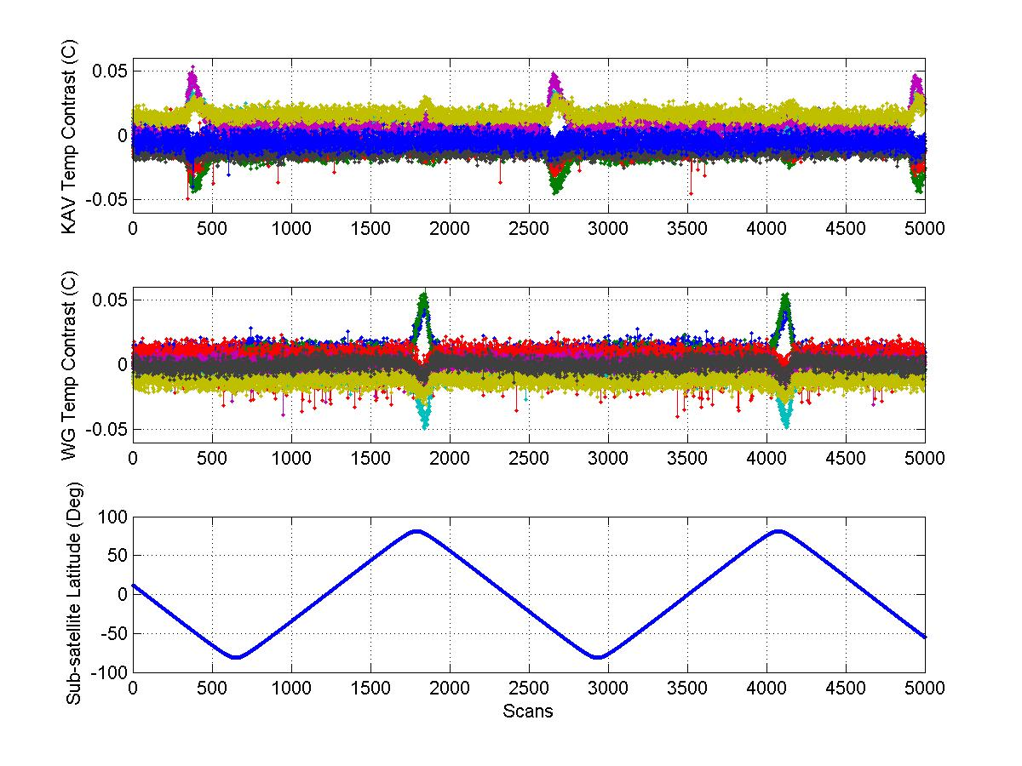
Warm Load Temperature Contrast Patterns
Warmload temperature contrast spiked around the north pole for the WG bands. Similar spikes occurred at ~45 degree south for the KAV bands. Alex Foo and Degui Gu (NGAS)

Slide 6
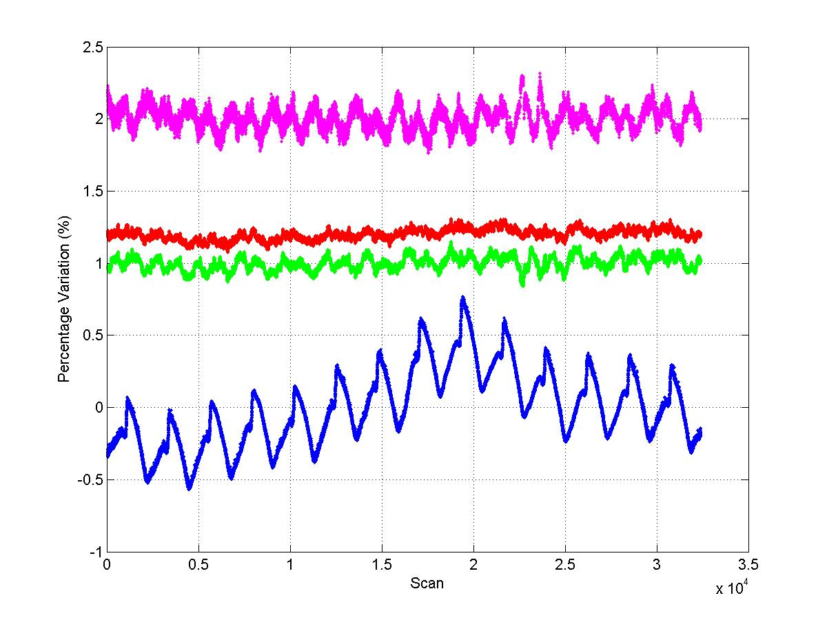
ATMS Calibration Data Consistency Assessment
CHANNEL 16
GAIN Variability (%). Shifted 2%
Warm (R) and Cold (G) Counts Variability (%). Shifted 1-1.2%
PRT Temperature Variability (%)
ATMS calibration data consistency check. Channel 16. Nov 18, 2011. Data downloaded from GTP. Cold counts have more variability than warm counts, and gains also show significant variability, most likely due to sidelobe effects (Alex Foo and Degui GU, NGAS)

Slide 7
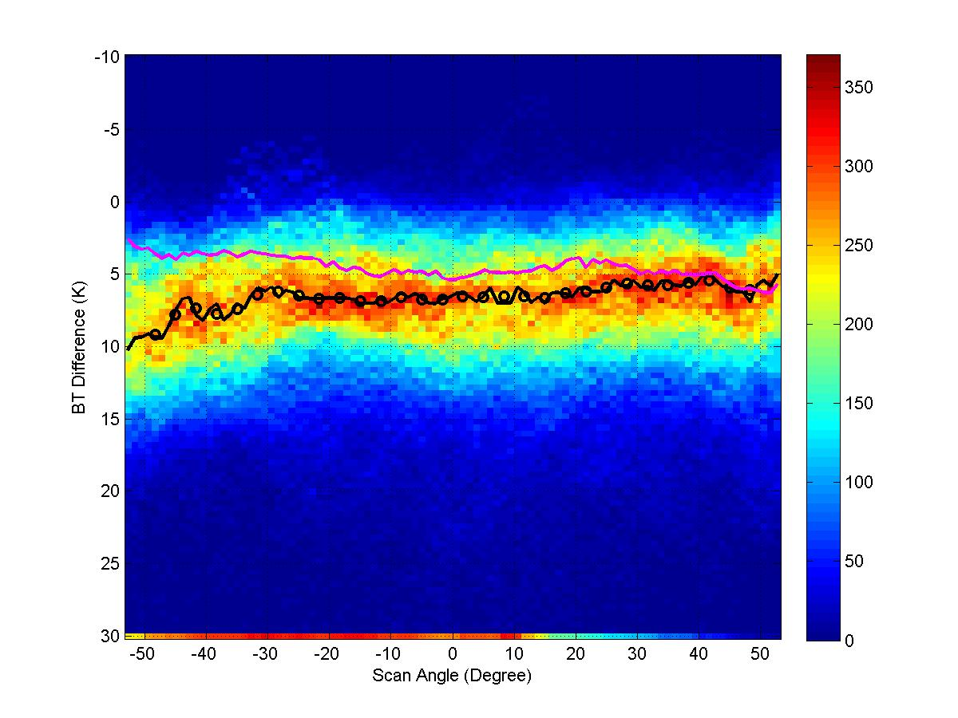
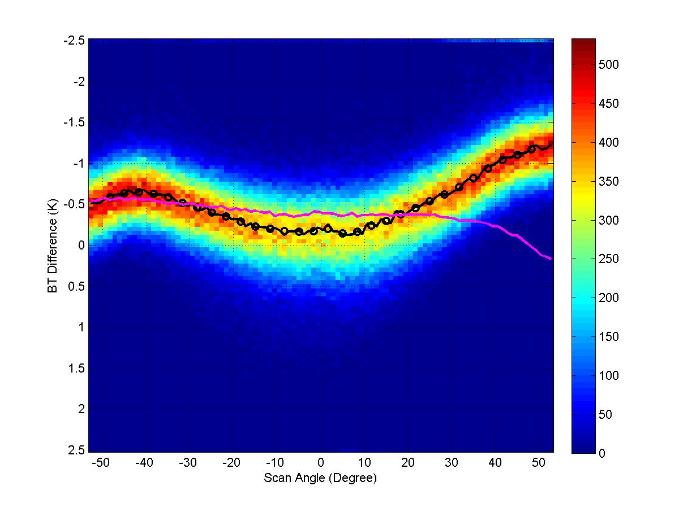
NGAS ATMS Cal/Val Highlights (2/7)
Evaluated ATMS SDR data product quality and compared to the forward model simulations to evaluate scan-dependent biases
ATMS SDR bias estimates (Channel 1)
ATMS SDR bias estimates (Channel 6)
NGAS Estimates
Xia-Lin Ma, Alex Foo and Degui Gu (NGAS)

Slide 8
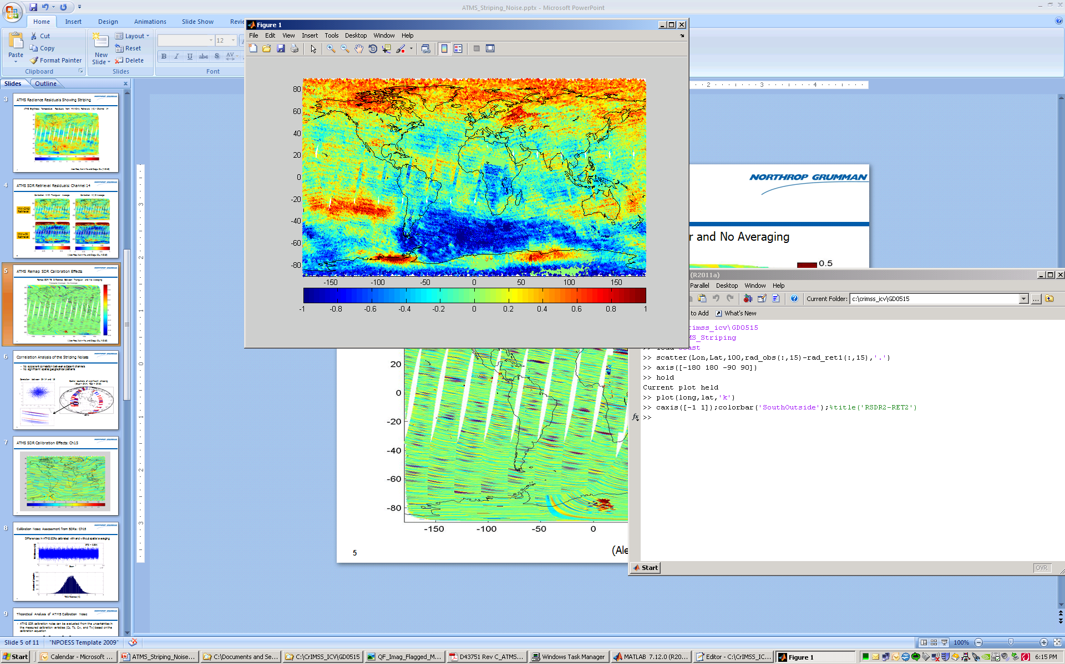
NGAS ATMS Cal/Val Highlights (3/7)
Discovered ATMS SDR striping noise issue and investigated the root cause
  Concluded that the striping is caused by ATMS SDR calibration noise, specifically the noise in the warm counts. The level of the striping noise is insignificant and well within ATMS SDR noise spec level
  SDR algorithm has since been updated to reduce the striping noise
ATMS Remap SDR Brightness Temperature Difference: Simulated – Observed
ATMS remap SDR striping noise. Channel 15. Golden Day 5/15/2012. Alex Foo and Degui Gu (NGAS)

Slide 9
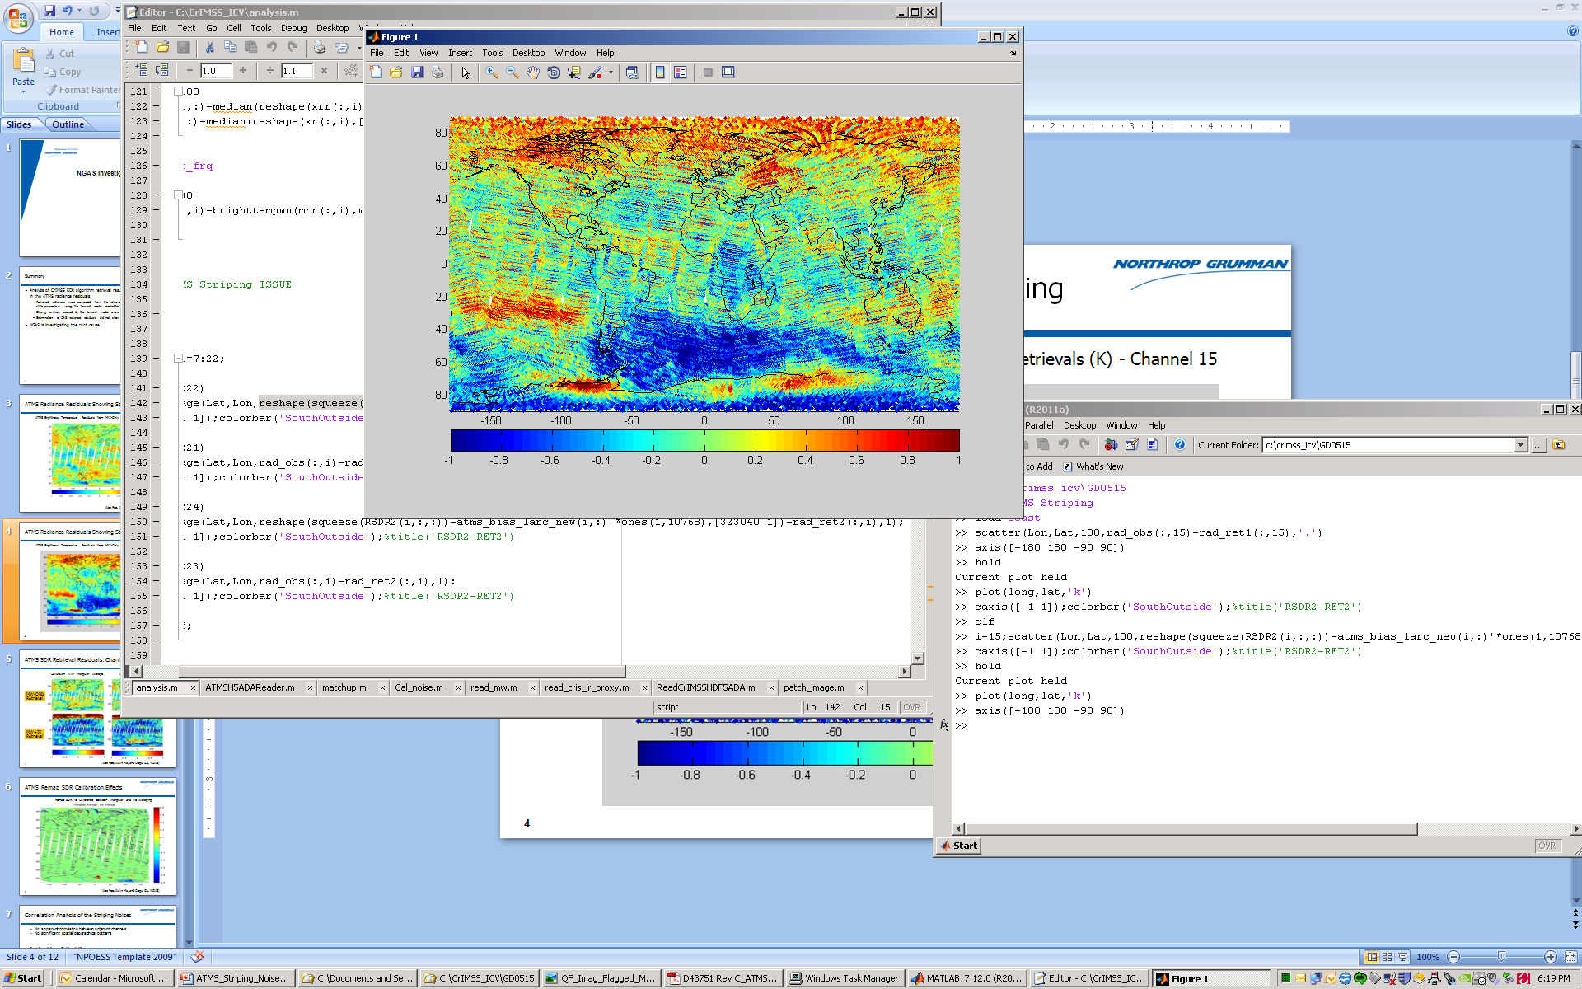
More Striping if Calibration Data not Averaged
ATMS Brightness Temperature Difference: Simulated – Observed (without averaging)
ATMS Remap SDR striping noise. Channel 15. Golden Day 5/15/2012. Calibration data is not averaged. Data generated on G-ADA using MX5.3. Alex Foo and Degui Gu (NGAS)

Slide 10
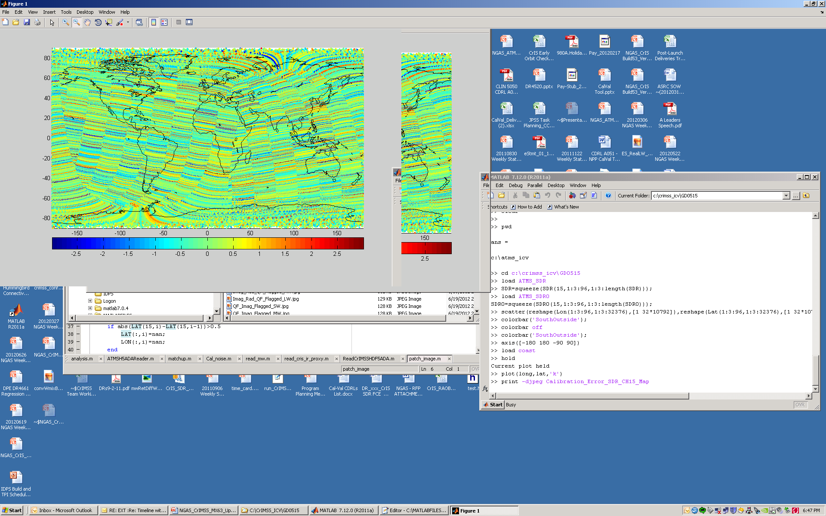
TB Difference With and Without Averaging
ATMS SDR TB difference with (triangular) and without averaging
Difference of ATMS SDR brightness temperature with and without averaging the calibration data. Channel 15. Golden Day 5/15/2012. Data generated on G-ADA using MX5.3. Alex Foo and Degui Gu (NGAS)

Slide 11
Correlation Analysis of ATMS Striping Noise
No apparent correlation between adjacent channels
No significant spatial/geographical patterns
Correlation between CH 14 and 15
Spatial locations of significant stripping (Blue – Ch14; Red – Ch15)
(Giovanni De Amici, NGAS)

Slide 12
Theoretical Analysis of ATMS Calibration Noise
ATMS SDR calibration noise can be evaluated from the uncertainties in the measured calibration variables (Cc, Tc, Cw, and Tw) based on the calibration equation
Ignoring the second-order terms to estimate the noise component of calibration error:
For channel 15, Tw~=280K; T ~= 240K (220-260);
Cold Counts Noise
Warm C Noise
Warm T Noise

Slide 13
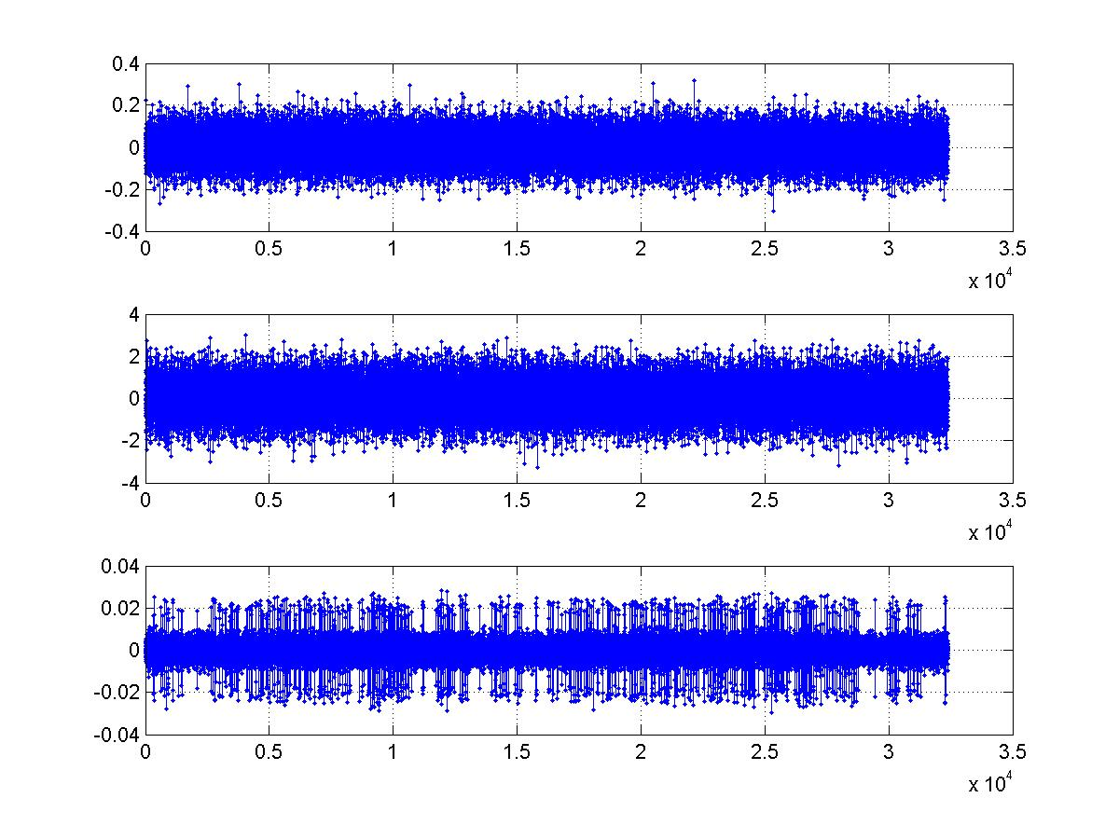
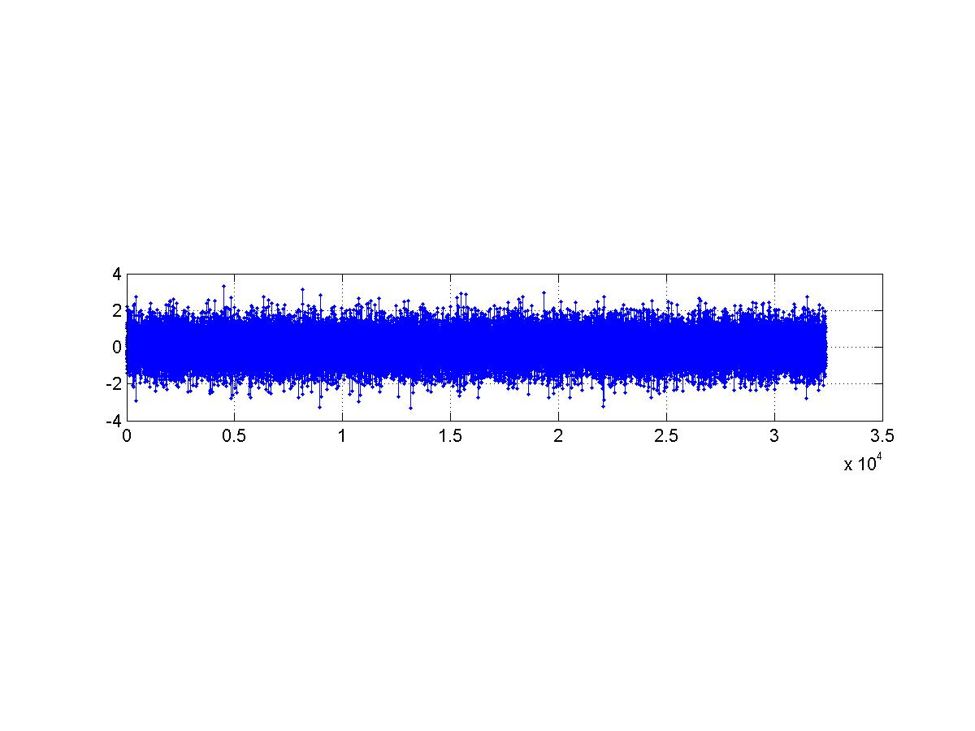
ATMS Striping Noise Caused by Warm Counts Noise: Example Ch15
PRT temperature noise STD = 0.005K
Calibration noise analysis from RDRs
RDR data from 11/19/2011
Cold counts noise STD = 0.07K
Main Cause of Calibration Noise
Warm counts noise STD = 0.81K
SDR calibration noise STD = 0.80K
SDR data from 5/15/2012
Alex Foo and Degui Gu (NGAS)
ATMS Scans

Slide 14
NGAS ATMS Cal/Val Highlights (4/7)
Supported the validation of ATMS Remap SDR data product
  Verified IDPS remapped SDRs products are consistent with NGAS offline results. ATMS remap SDR code and LUT are correctly implemented at IDPS
  Compared IDPS remapped SDRs to the collocated (nearest) ATMS SDRs to ensure consistency
    Biases are small, within 0.2K for all channels and scan angles
    Standard deviations vary for different channels, consistent with channel noise characteristics and scene variability
  Validated BG approach to have high fidelity in spatially interpolating ATMS data
    ATMS native foot prints can be re-constructed using nearby footprints using BG approach with high accuracy
    Biases are very small and insignificant - a few exceptions near the edge of the scan
    Standard deviations are consistent with data noise characteristics and scene variability

Slide 15
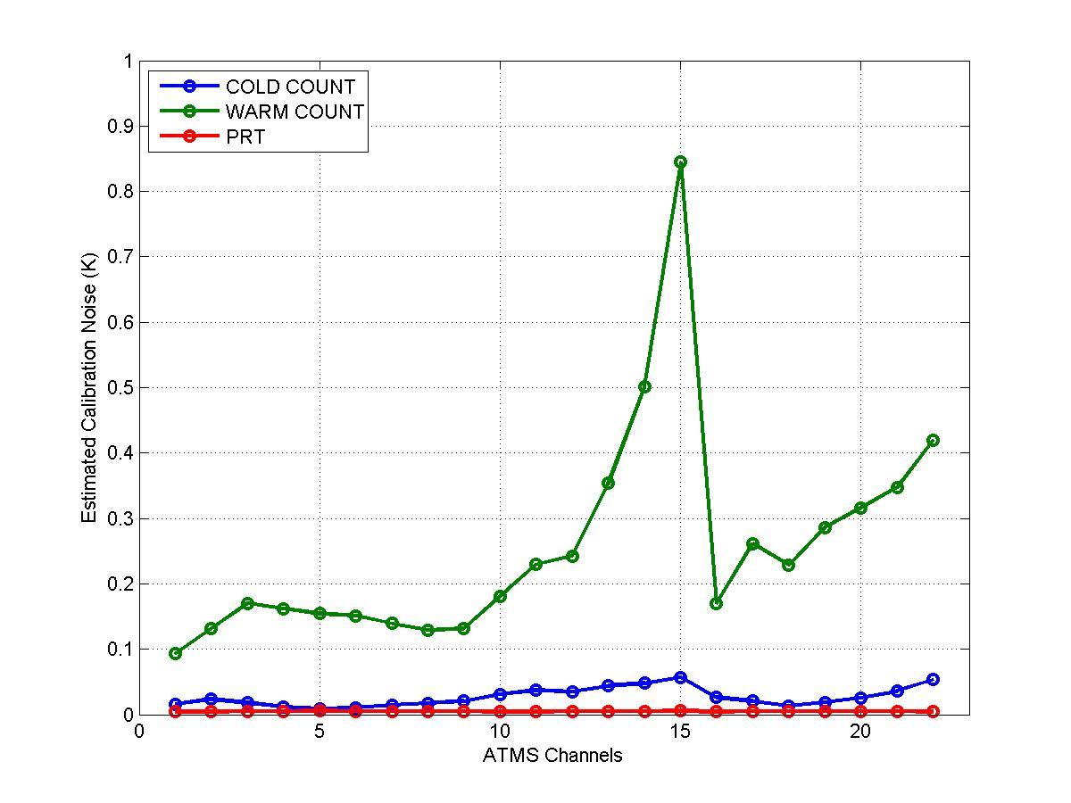
Assessment of Residual Calibration Noise Level
Estimated ATMS SDR residual calibration noise without spatial averaging
Spatial averaging of calibration data expects to reduce the residual calibration noise by a factor of 2-3. However, calibration noise is spatially correlated, and can’t be effectively reduced by remapping (e.g., B-G). (Alex Foo and Degui Gu, NGAS)

Slide 16
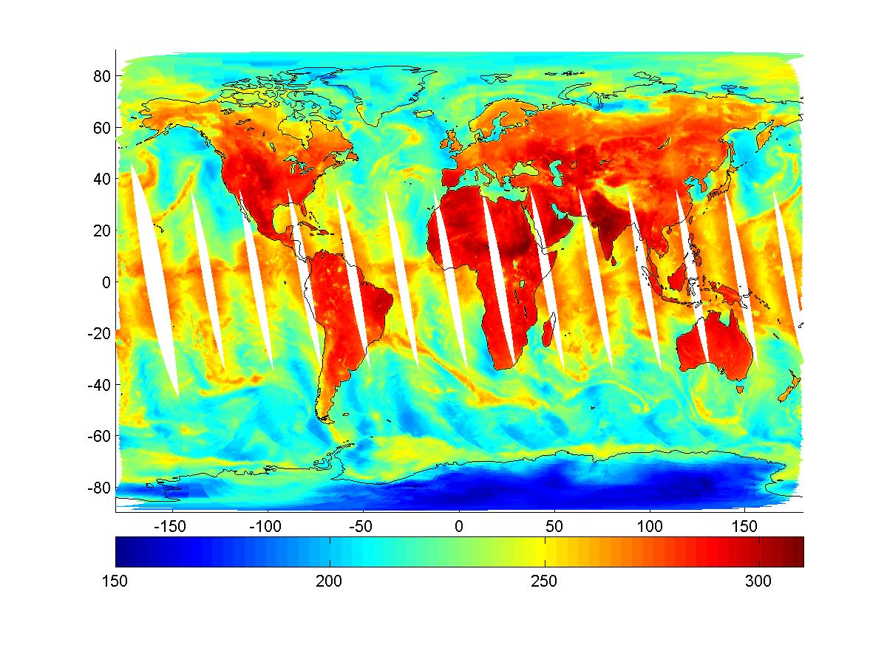

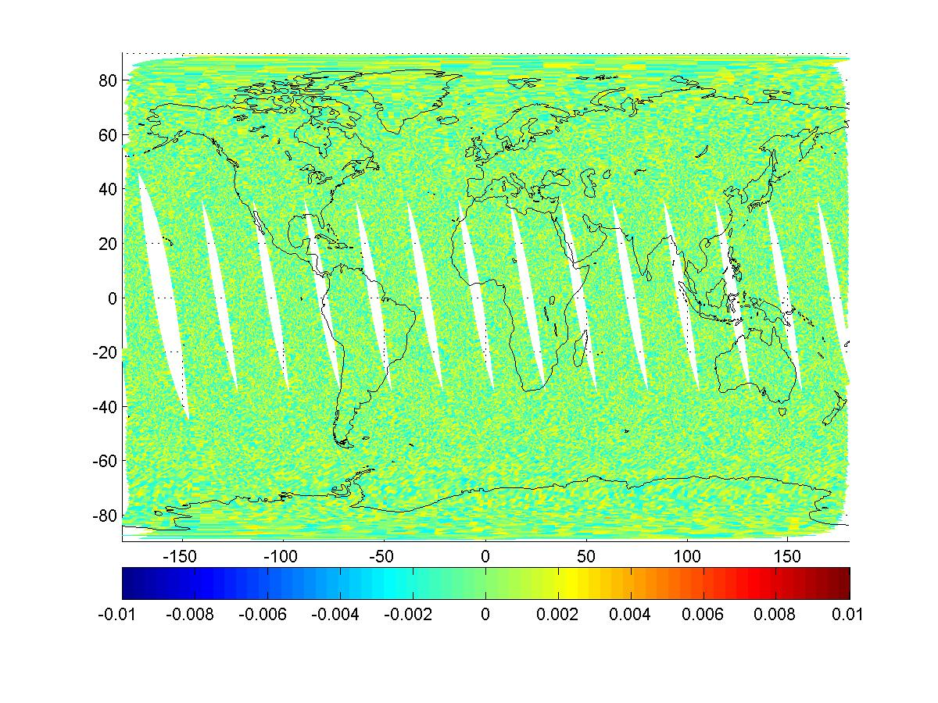
ATMS Remap SDR Products Matched with NGAS Offline Results
IDPS Remap SDR (CH 16)
NGAS Offline Remap SDR (CH 16)
Difference (K)
IDPS Remap SDRs matched with NGAS Remap SDRs
Difference between IDPS and NGAS offline remap SDRs are very small and believed to be due to platform difference
This verified IDPS implementation of NGAS code and LUT correctly
Alex Foo and Degui Gu (NGAS)

Slide 17

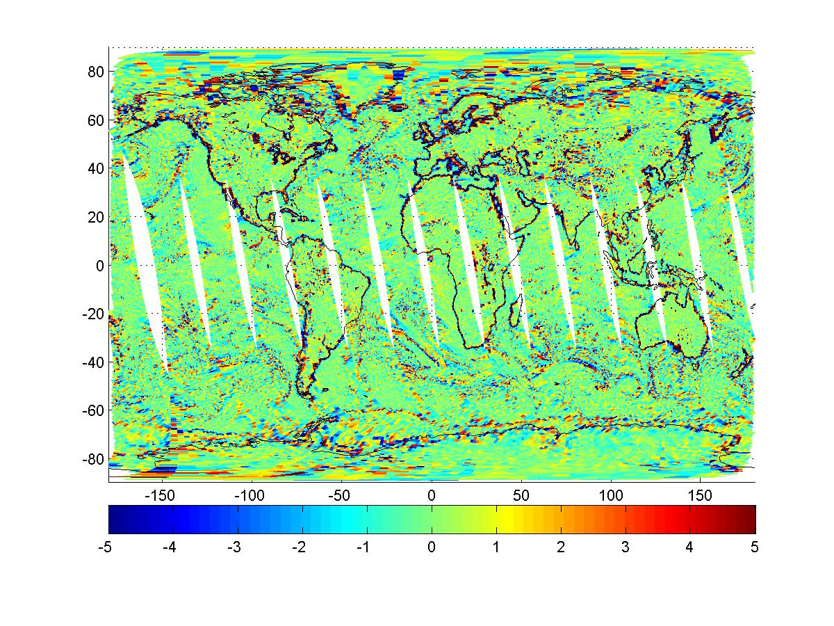
ATMS Remap SDR Product Compared Consistent with NGAS Offline Results
IDPS Remap SDR (CH 16)
Collocated ATMS SDR (CH 16)
Difference (K)
IDPS Remap SDRs are consistent with the collocated native ATMS SDRs
Largest differences mostly along coast lines and high contrast areas, due to differences in footprint size and antenna pattern
This comparison provided a sanity check of the quality of the Remap SDR products
Alex Foo and Degui Gu (NGAS)

Slide 18
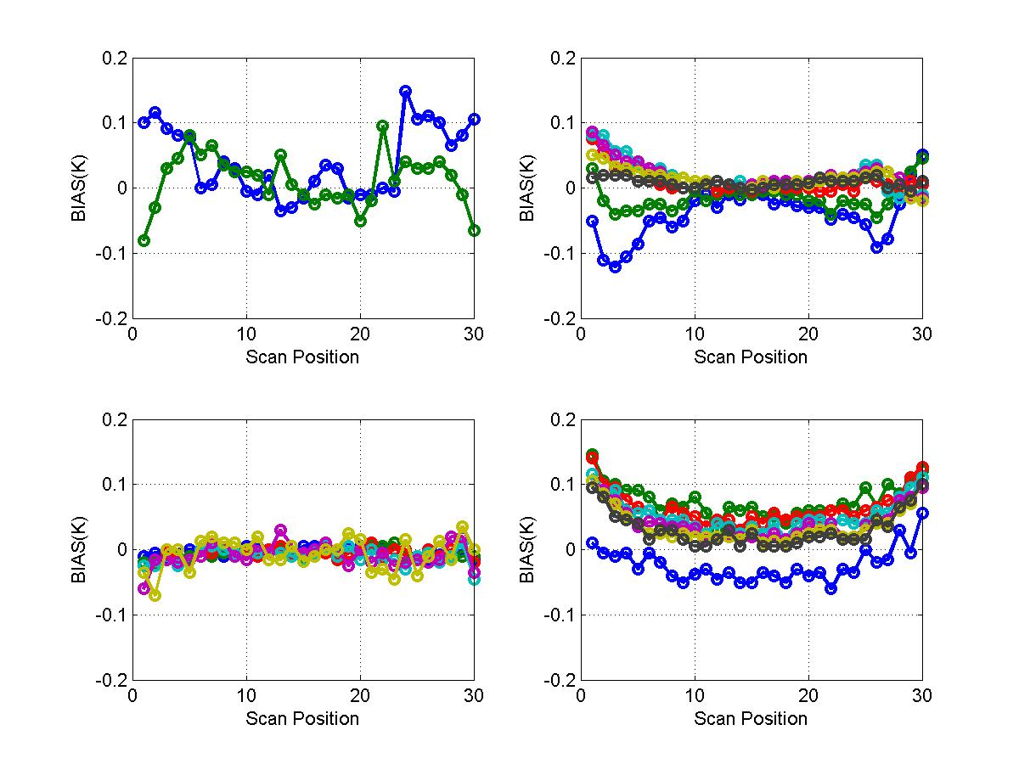
No Significant Biases Between Remapped SDRs and Collocated ATMS SDRs
Channels 1 & 2
Channels 3 - 9
Channels 10-15
Channels 16-22
The biases between the remapped SDRs and the collocated SDRs are small, likely a result of sampling error. Alex Foo and Degui Gu (NGAS)

Slide 19
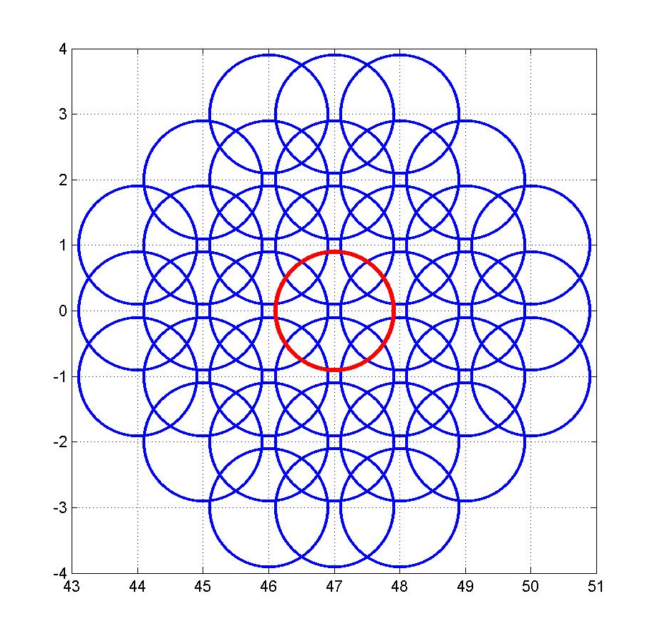
Validation of B-G Approach: Reconstruction of ATMS Footprints from Adjacent FOVs
ATMS footprint reconstruction (Ch16 FOV 47)
ATMS data are over-sampled (K, Ka, V and W bands)
Native footprints are constructed from nearby footprints to validate B-G approach
Footprint patterns based on those used for generating IDPS remapping coefficients LUT – not optimized for native footprint construction
In-track position
Chunming Wang and Degui Gu (NGAS)
Cross-track position

Slide 20
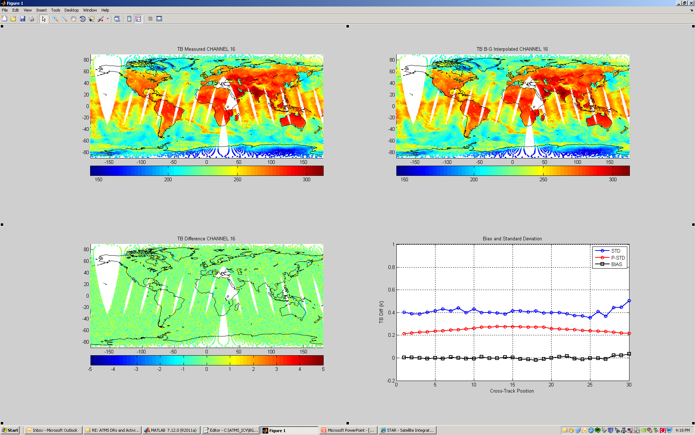
ATMS Footprints Accurately Constructed from Adjacent Footprints: Example Channel 16
Comparison of measured and re-constructed ATMS radiances, Channel 16. Golden Day 5/15/2012. Alex Foo and Degui Gu (NGAS)

Slide 21
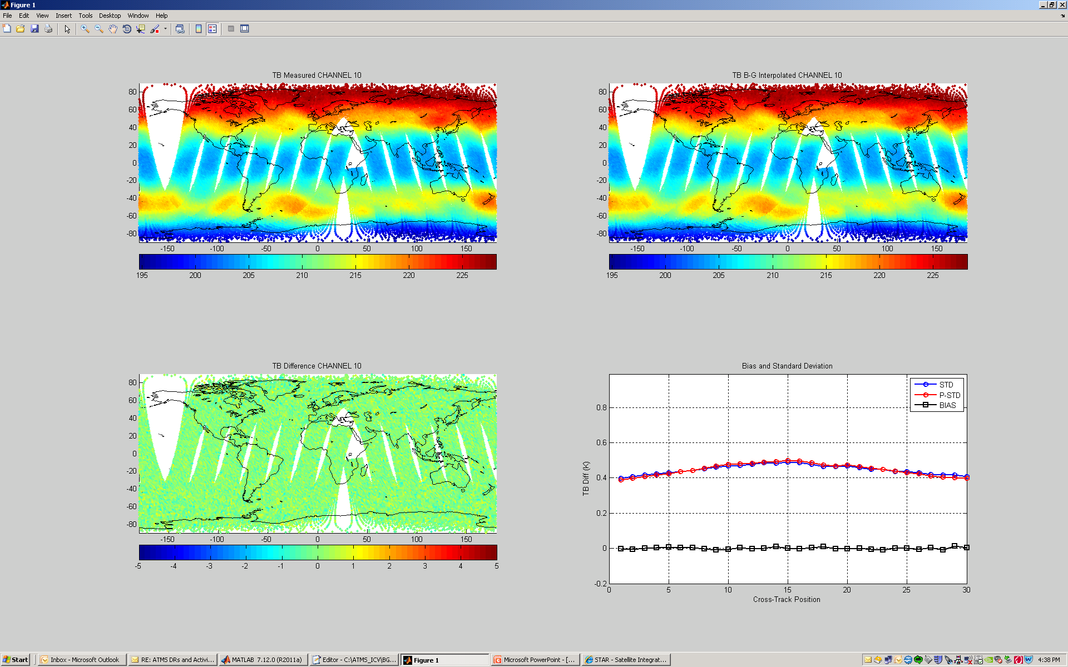
Another Example to Show B-G Approach as a Validated Footprint Matching Method: Channel 10
Comparison of measured and re-constructed ATMS radiances, Channel 10. Golden Day 5/15/2012. Alex Foo and Degui Gu (NGAS)

Slide 22
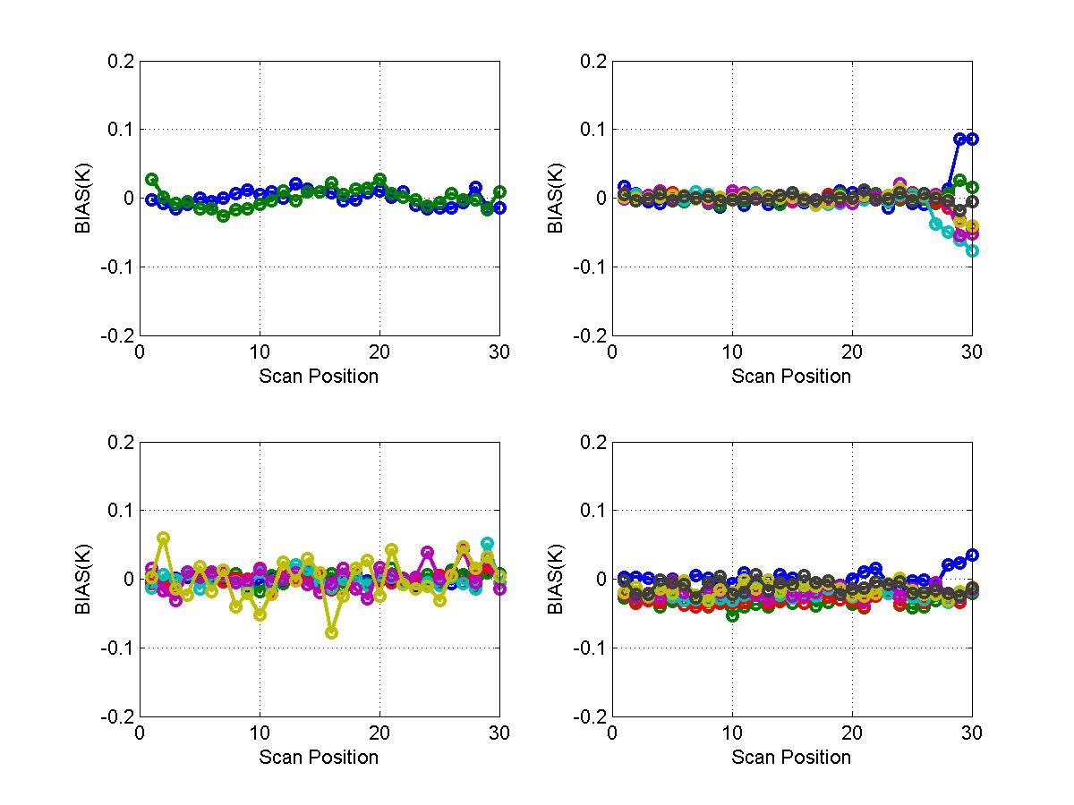
No Significant Biases Between the Measured and the Reconstructed ATMS Brightness Temperatures
K/Ka bands (Ch 1 & 2)
V band (Ch 3 – 9)
V band (Ch 10-15)
W/G bands (Ch 16-22)
Residual biases between the measured and the reconstructed ATMS radiances. Golden Day 5/15/2012. Alex Foo and Degui Gu (NGAS)

Slide 23
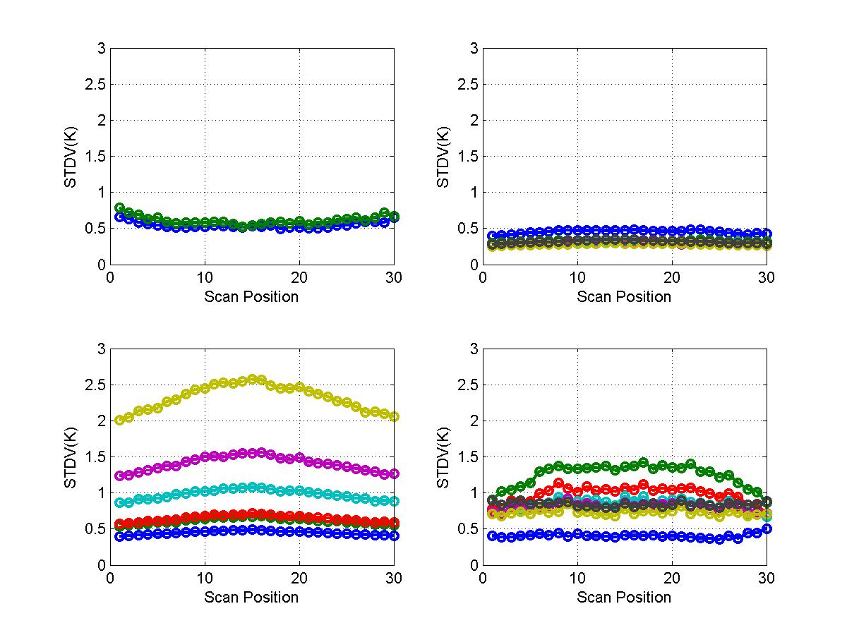
No Significant Errors Introduced in the Reconstructed TB Images for V & W Bands
K/Ka bands (Ch 1 & 2)
V band (Ch 3 – 9)
Larger error along coastlines
V band (Ch 10-15)
W/G bands (Ch 16-22)
Larger errors around high contrast spots for G band
Standard deviation of differences between the measured and the reconstructed ATMS radiances. Golden Day 5/15/2012. Alex Foo and Degui Gu (NGAS)

Slide 24
NGAS ATMS Cal/Val Highlights (5/7)
Supported DR resolutions and anomaly investigation
  DR 4413: New ATMS-CrIS Synch test and Ref data generation on G-ADA
  DR 4522 related: Lunar intrusion verification
  GPS Anomaly
  DR 4510: Duplicates in ATMS REMAP
  DR 4732: REMAP SDR ATMS-CrIS Synch QF still triggered in MX5.3
  DR 4413: REMAP SDR ATMS-CrIS Synch QF is triggered in MX5.2
  DR 4642: Ops GEO does not match G-ADA for Focus Day 2012-02-25
  DR 4561: G-ADA results do not agree with Ops and QF from G-ADA run are triggered while RDR OK
  DR 4561 related: MIT-LL’s ADL results do not match Ops and G-ADA results (false HS Flags)
  DR 4479, 4463, 4462, 4460, 4446: QF triggering anomalies
  Analysis of ATMS & CrIS timestamps to confirm CrIS/ATMS synchronization and recommendation for future update
  Investigation of ATMS remap SDR not matching ATMS SDRs
  Investigation of PRT temperature discontinuity
  Verification of MX6.3 anomaly

Slide 25
NGAS ATMS Cal/Val Highlights (6/7)
Supported IDPS operational algorithm updates and verification
  Delivered ATMS remap SDR PCT to update the CrIS and ATMS sensor synchronization parameter values
    Including test and verification on G-ADA
  Performed test and verification of ATMS code update by MIT-LL on G-ADA
  Performed test and verification of ATMS SDR PCT update by MIT-LL on G-ADA
  Supported verification of MX6.3 IDPS implementation
Reprocessed Golden Day datasets (Feb 24-26, May 15, Sep 20) to support ATMS and CrIMSS CalVal teams and verification of IDPS operational code/LUT updates

Slide 26
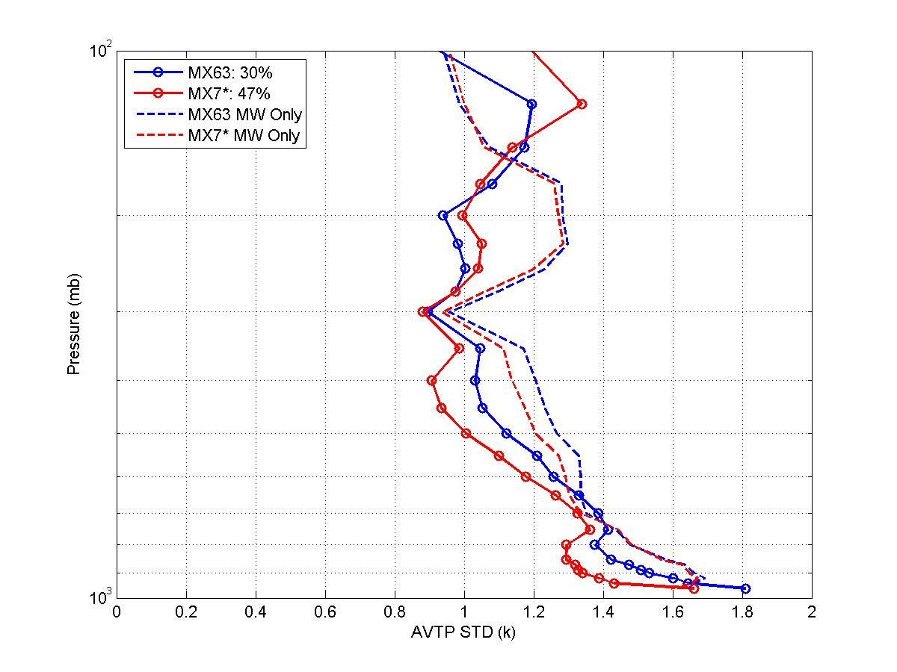
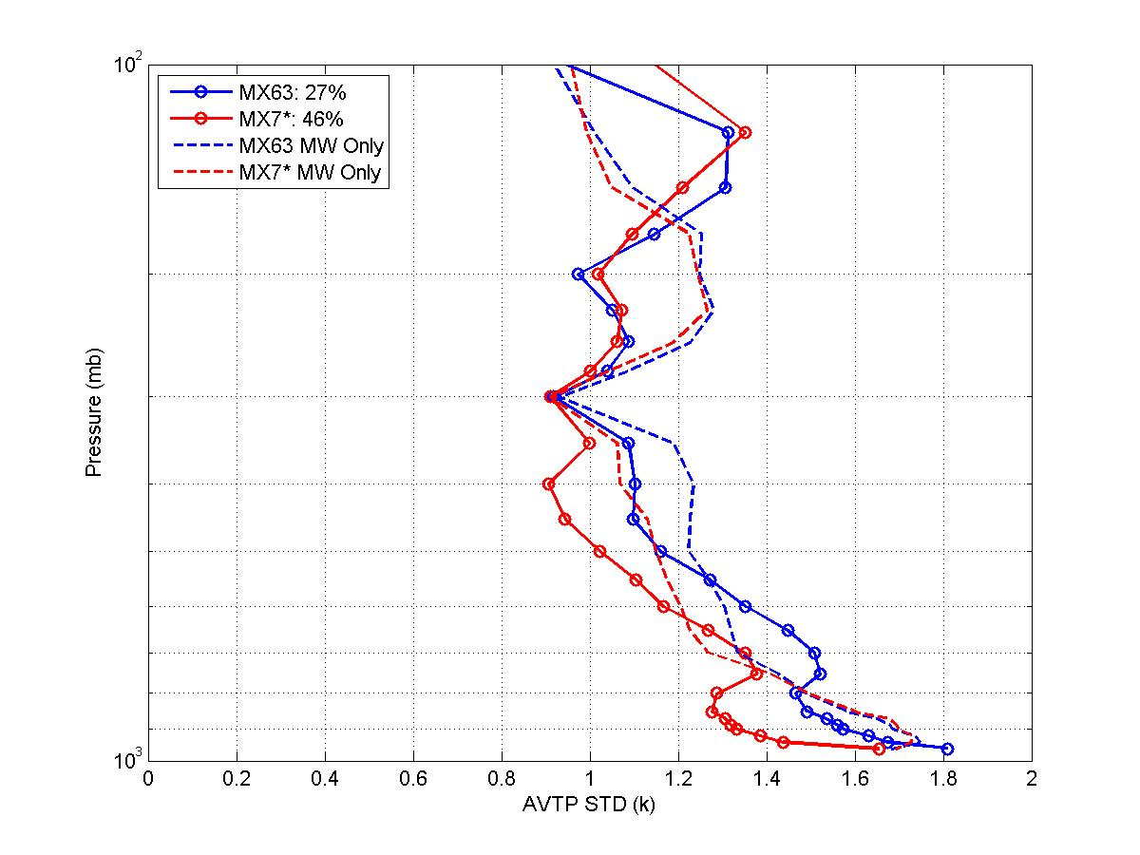
NGAS ATMS Cal/Val Highlights (7/7)
Night Ocean Scenes
Daytime Ocean Scenes
Excellent quality of CrIMSS EDR products retrieved from ATMS and CrIS data. Ocean only. Golden Day 5/15/2012. Xialin Ma, Alex Foo, and Degui Gu (NGAS)

Slide 27
Summary and Future Work
The operational ATMS SDR data products (including the remapped SDRs) have been verified to be stable and with excellent quality
NGAS team will continue to support NPP ATMS Cal/Val activities
  Operational algorithm code /LUT update and verification
  SDR and remap SDR data product validation
  DR investigation and anomaly resolution

